Slide 1

What does it solve?
Vasanth Krishnamoorthy

Slide 2
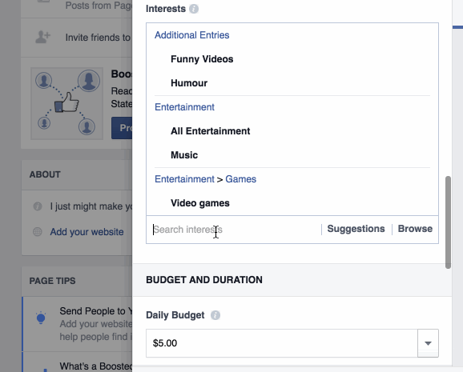
The Problem

Slide 3
Hacky initial solution
Idea
  Re-render the page on any change.
Pros
  Data flow and UI is simple to understand (like 90s)
Cons
  Performance hit: Rendering all the elements is a bad idea. Culprit: DOM

Slide 4
Better solution is to cheat
How can we not touch the DOM often, but still know which parts of the UI should change?
Solution:
  Have a memory representation of the DOM and make changes there.
  Virtual DOM

Slide 5
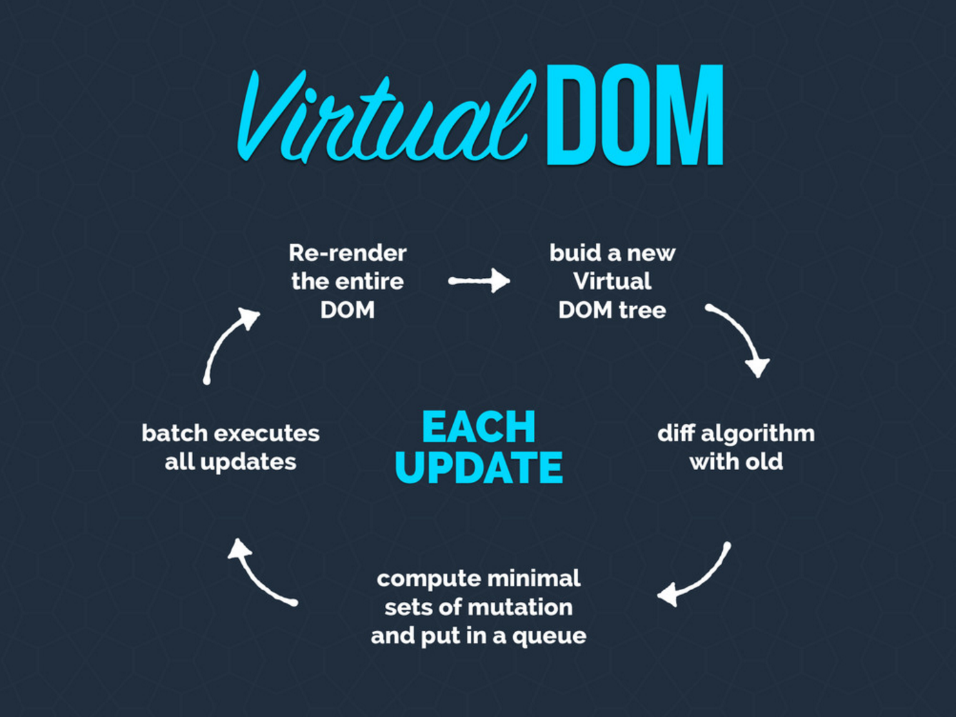

Slide 6
Virtual DOM benefits
Fast: All changes are done in the Virtual DOM
Less Jank: React batches changes/updates to the DOM in a sequence leading to lesser reflows/recalcs
Security: Eliminates XSS vulnerabilities.
Server Render: Can run on Node.js with no browser
Notes:
React basically makes it so you can't insert markup unless you create the elements yourself in the render function.
http://stackoverflow.com/a/33644981/1672655

Slide 7
Traditional UIs
Traditional
  Programs tend to be composed of objects that talk to each other in different manners, all with their own state.
  This often leads to bugs, with the state somewhere in the app getting in an unexpected state, breaking things.
  This is the way we've programmed for years, which is the reason why "have you tried turning it off and on again" is an advice that works so well for devices that use any kind of software.

Slide 8
React
Your app state is mostly constrained to a single place, and your app is instead made up of stateless functions that react to the state changing, and pipe their results to React, which re-renders it.
This execution flow is generally much easier to reason about because side-effects doesn't happen all over the place.

Slide 9
Component driven development
React favors composition
UI = Composition(components)
The idea is to follow the single responsibility principle and ideally, design your components to be responsible for only one thing.

Slide 10
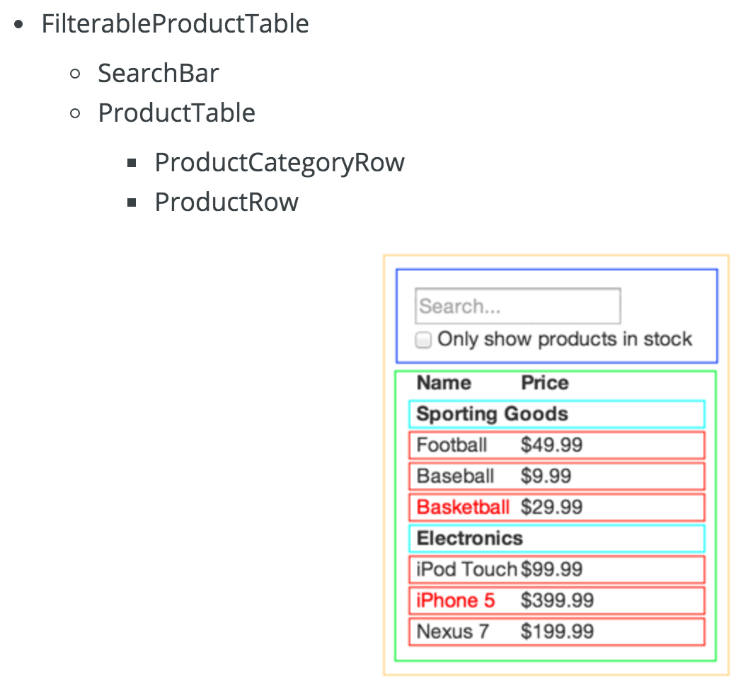
Thinking in React
Demo

Slide 11
When to use React?
“Any app with state that changes a lot will benefit from React”
Eg. Chat Apps, Facebook (obviously), Dynamic UIs (Netflix), Interactive Forms etc.

Slide 12
Questions to ask before picking React.js
Am I building an app which has lots of DOM interactions?
Does my app require a high browser performance, that any user interactions must immediately be reflected in the UI? Is my data going to change over time at a high rate?
Is one user interaction going to affect many other areas/components in the UI?
Is there a possibility that my app could grow big in the future, and so I would want to write extremely neat, modular front-end JavaScript that is easy to maintain?
Would I prefer a framework/library which does not have a high learning curve and which is pretty easy to get started with development?
Finally, just say Yes to React ☺

Slide 13
Final thoughts
React is just the V in the MVC – So it is easy to plug it in to existing apps and test it out.
React introduces a bunch of functional programming principles into mainstream JS and this changes the way we think about front end code abstractions. This is a compelling reason to explore React.
Philosophy: “Learn once, write anywhere.”
  React Native enables us to share our views between Web/Android/iOS versions of the App
  - This is a boon for us JS developers to build cross platform apps - Might as well be the future ☺

Slide 14
Thank you
Any Questions??

